Slide 1
#FEwhitepaper

Slide 2
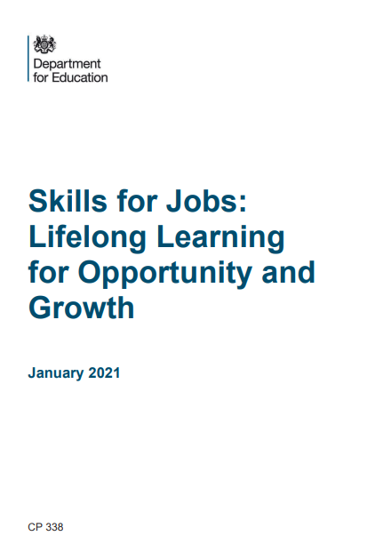
The FE White Paper in numbers
6 chapters including summary
32 sections within the chapters
34 policy ‘decisions’
80 pages
156 paragraphs
25,143 words
140,806 characters (no spaces)
166,107 characters (with spaces)
Very wide ranging!
https://www.gov.uk/government/publications/skills-for-jobs-lifelong-learning-for-opportunity-and-growth
#FEwhitepaper

Slide 3
What’s does Gavin say is the big theme?
“This White Paper aims to strengthen links between employers and further education providers. We will place employers at the heart of defining local skills needs and explore a new role for Chambers of Commerce and other business representative organisations working with local colleges and employers.”
Repeat after me: from employer ownership -> to employer-led
https://www.gov.uk/government/publications/skills-for-jobs-lifelong-learning-for-opportunity-and-growth
#FEwhitepaper

Slide 4
One-year funding commitment (not 3)
“The courses offered by providers will be tailored to meet the skill needs of businesses. We will support their delivery through £1.5 billion of capital funding to improve the condition of further education colleges, a further £291 million to support 16-19-year-olds and £375 million to deliver our contribution to the Plan for Jobs in 2021-22 and start delivering our Lifetime Skills Guarantee.
Other legislation in the pipeline (hence being a white paper)?
“And we need all our further education providers to be well managed, governed and have the best quality teachers and lecturers”
https://www.gov.uk/government/publications/skills-for-jobs-lifelong-learning-for-opportunity-and-growth
#FEwhitepaper

Slide 5
Next phase of employer-led: like Germany?
A £65 million Strategic Development Fund to establish “College Business Centres” within FE colleges, which will offer capital and revenue funding to help colleges “respond to locally agreed priorities” –DfE told us £65m but there is no mention of budget in the white paper
New legislation to give Chambers of Commerce leadership of new Local Skills Improvement Plans – somehow not duplicating the work of devolved FE funders
Give employers a “central role” in designing “almost all” technical courses by 2030, to “ensure that the education and training people receive is directly linked to the skills needed for real jobs” – huge role for IfATE working with Ofqual
https://www.gov.uk/government/publications/skills-for-jobs-lifelong-learning-for-opportunity-and-growth
#FEwhitepaper

Slide 6
Raft of reforms already in train
Bootcamps: 12-16-week courses with ‘up to’ £43 million in 2021/22 from National Skills Fund to expand nationally into several sectors. Currently a tender taking place with 12 February deadline – totally new funding formula, no ILR (!) and so far no sign of Ofsted (!!) - I think the ‘bootcamp’ name came from No10 back in October and I cannot find anyone that likes it
Lifetime Skills Guarantee: expansion of the existing first full level 3 entitlement from April 2021 (£95m budget) to include all ages – but with a very limited number of eligible courses chosen for being of economic value. Like bootcamps, funded from the new National Skills Fund but ESFA needing to use a ring-fence in the Adult Education Budget as temporary measure. – expect tension between devolved mayoral authorities who will want more qualifications and sectors eligible
https://www.gov.uk/government/publications/skills-for-jobs-lifelong-learning-for-opportunity-and-growth
#FEwhitepaper

Slide 7
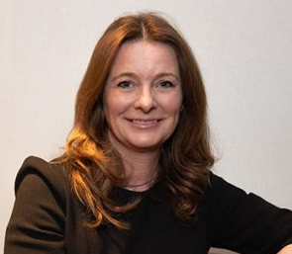
Fascinating FE Week interview with the Skills Minister Gillian Keegan (1/2)
“Some of it has been announced before. I don’t know why people get so obsessed about it being announced before ̶ it’s all part of the same strategy, some of which we’ve been working on to be able to start to get people ready to deliver it. But it’s all part of the same strategy, which is closing the skills gap, where we put employers at the centre of our qualifications and working with FE colleges and local skills improvement plans to basically make sure that we bring the system together.”
https://feweek.co.uk/2021/01/21/white-paper-qa-with-skills-minister-we-have-got-an-awful-lot-to-do-and-an-awful-lot-to-prove/
#FEwhitepaper

Slide 8
Fascinating FE Week interview with the Skills Minister Gillian Keegan (2/2)
Would a 3-year spending settlement have been more preferable?
“The fact is, I don’t know. But I do know that trying to deliver a flexible, more modular approach with the lifelong loan entitlement, a level 3 entitlement, bootcamps, Institutes of Technology and T Levels, that is a massive programme in itself.”
“I feel there is a lot to deliver. Would I want more to deliver? Not necessarily. Sometimes there is a case of, well, if you argue for more stuff but you can’t spend it because you can’t actually deliver it, well, then that doesn’t always end well.”
https://feweek.co.uk/2021/01/21/white-paper-qa-with-skills-minister-we-have-got-an-awful-lot-to-do-and-an-awful-lot-to-prove/
#FEwhitepaper

Slide 9
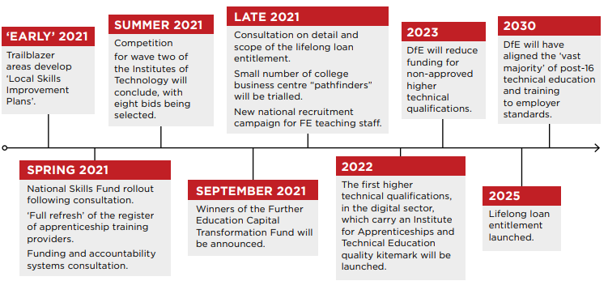
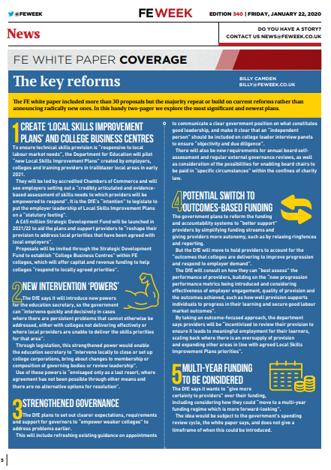
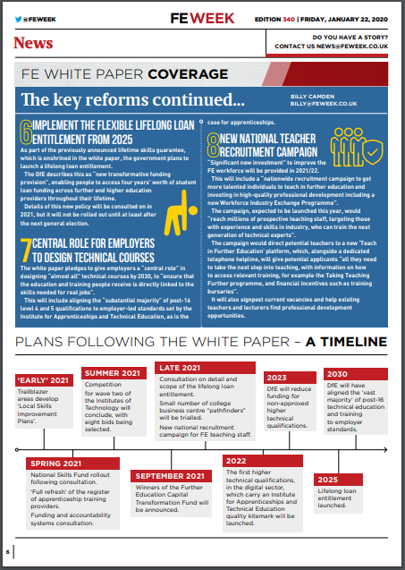
What next?…
Implement the flexible Lifelong Loan Entitlement to the equivalent of four years of post-18 education from 2025
National Skills Funding consultation to reform the FE funding system and make it ‘simple’ - unclear how simple given devolution of skills funding in many areas
Source: FE Week
We will send out our handy #Fewhitepaper summary after the webcast
#FEwhitepaper

Slide 10
Discussion
David Hughes, CEO, Association of Colleges
Dr Sue Pember, Holex
Jane Hickie, CEO, AELP
David Russell, CEO, Education & Training Foundation
David Gallagher, CEO, NCFE
#FEwhitepaper

