Slide 1
OFFICIAL
Rob Nitsch CBE
Chief Operating Officer
Institute for Apprenticeships
South West Employer Conference
Exeter - 30 November 2018

Slide 2
Institute’s Role
Development of new apprenticeship standards and the review of existing standards, including making recommendations to Ministers on the most appropriate funding band.
Quality Assurance of both End Point Assessment (EPA) and Endpoint Quality Assurance (EQA).
Development and approval of the content of new T Levels, and the procurement and contract management of T levels.

Slide 3
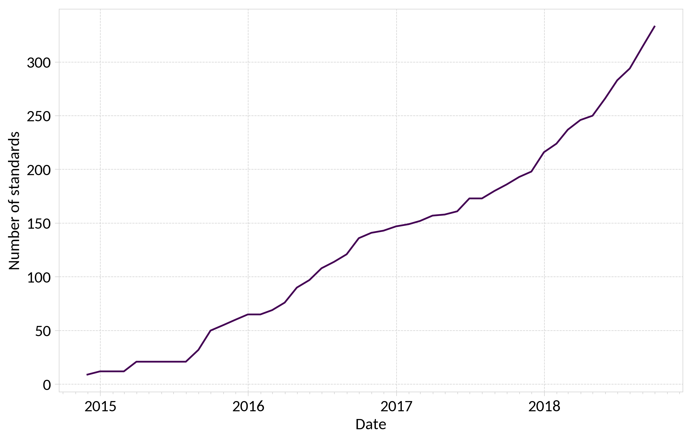
# of Apprenticeship Standards Approved for Delivery
*Standards approved for delivery as at 22 June 2018
Notes:
Source data can be downloaded via:
https://www.instituteforapprenticeships.org/apprenticeship-standards/

Slide 4
Standards Development Time and Distribution
Notes:
Provisional performance information, showing a general trend of decreasing development time for standards. We intend to publish information along these lines in the new year, once we have finished development and quality assurance.

Slide 5
Cumulative Starts on Standards
Chart redacted
Notes:
The chart indicated the cumulative starts on standards by month and detailed level for academic year 2017-18, compared to the previous year. The original presentation contained internal management information that will not be publicly available until the end of January, and has therefore had to be redacted. Publicly available data that formed the basis of this chart is available as part of the further education and skills SFR:
https://www.gov.uk/government/collections/further-education-and-skills-statistical-first-release-sfr
With the specific breakdown, by month and detailed level, available: (https://assets.publishing.service.gov.uk/government/uploads/system/uploads/attachment_data/file/761151/Monthly-apprenticeship-starts_SSA-Fwk-Std-Age-Level-Fund_Nov2018.xlsx), which may give slight rounding differences with the main summary tables.
Annex A includes an updated version of this slide with the latest publicly available information.

Slide 6
Strengthening of Training
Charts redacted
Notes:
This slide contained a version of the expected hours of off-the-job training using internal management information not currently in the public domain and as such, the charts on this slide have been redacted. The publicly available data that made up this slide is available as part of the further education and skills SFR:
https://www.gov.uk/government/collections/further-education-and-skills-statistical-first-release-sfr
In the main text accompanying the November 2018 apprenticeship and levy statistics:
https://www.gov.uk/government/statistics/apprenticeship-and-levy-statistics-november-2018
Annex A includes an updated version of this slide with the latest publicly available information.

Slide 7
Quality Alliance – Quality Statement
An agreed partnership between employer, training provider and apprentice
A recognised occupation and a written standard which fully defines the occupation in terms of the responsibilities and tasks involved
Employment in a job which provides opportunities to cover the full occupational profile and learning all of the skills, knowledge and behaviours required
A training programme
Rigorous and independent end-point assessment

Slide 8
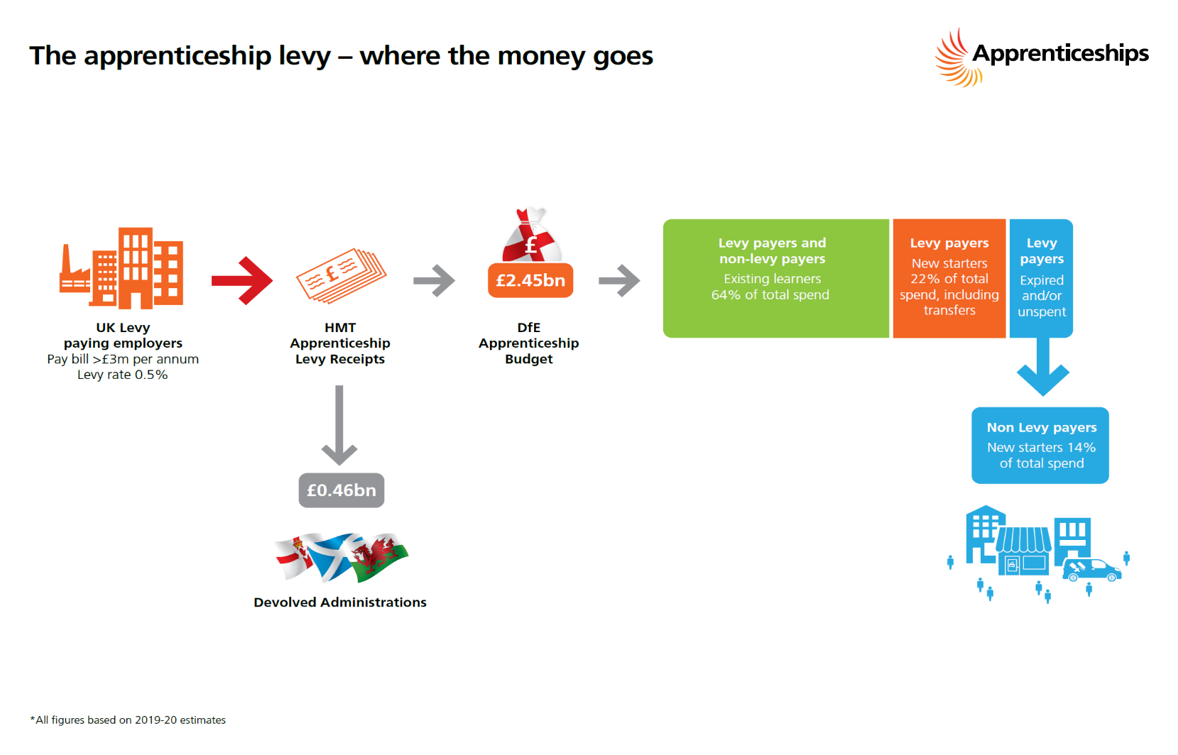
Apprenticeship Levy
Notes:
The flow chart is from the ‘Employer guide to apprenticeships’:
https://www.gov.uk/government/publications/apprenticeships-guide-for-employers
This was based on 2019-20 estimates prepared before the 2018 Budget announcements (which saw the 2019-20 budget increased to over £2.5 billion, with relevant increases in the budgets for the devolved administrations).

Slide 9
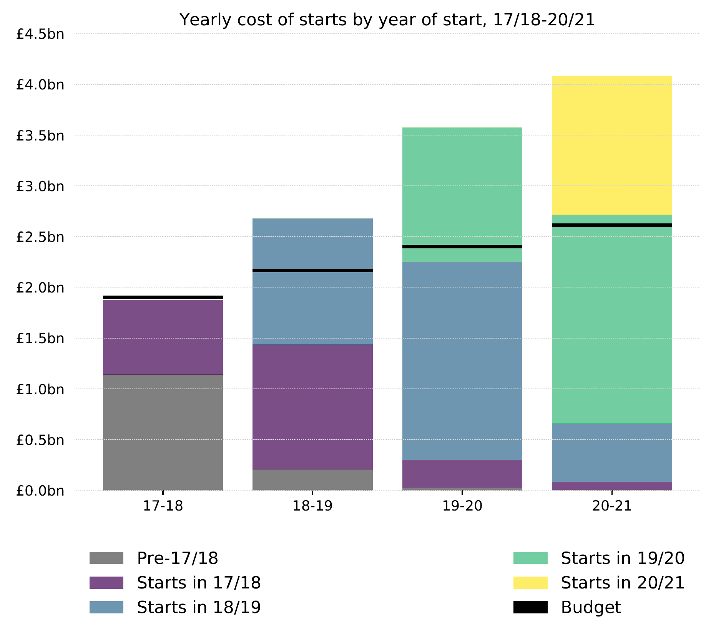
Notes:
This slide was intended to illustrate the broad point that the levy is a finite resource.
This chart presented a scenario prepared internally by the IFA about a year ago for policy discussion purposes. It was one of a number of possible illustrative projections and was not meant to be used publicly.
We will not be able to provide any details of the scenario modelled, as the data is not considered reliable for public consumption. To do so would be misleading, and risk compromising public understanding of the programme.
Further questions about this slide should be directed to the Department for Education.

Slide 10
Statutory Reviews – Timetable for Digital Pilot
Recommendations made to Route Panel and Institute’s Board
Launch Review and online consultation
Consultation of Trailblazer groups
Publish Review report & timeline for future reviews
Changes to standards/ assessment plans & funding completed within set period
Sept 18 | Oct 18 | Nov 18 | Dec 18 | Jan 19 | Feb 19 | Mar 19
Consultation closed
Institute analysis of evidence
Communicate Review outcomes to Trailblazer groups

Slide 11
Programme Challenges
National Standing
Funding the programme
Provider Capacity
Balancing Quality and Value for Money
Balancing Currency and Stability

Slide 12
T-Levels
Occupational Route | T-Levels
Education & Childcare | Education & Childcare
Construction | Building Services Engineering Design, Surveying & Planning Onsite Construction
Digital | Development & Digital Business Services Digital Production, Design & Development Digital Support & Services
Engineering & Manufacturing | Design, Development & Control Maintenance, Installation & Repair Manufacturing & Process
Health & Science | Health Healthcare Science Science
Legal, Financial & Accounting | Accounting Financial Legal
Agriculture, Environmental & Animal Care | Agriculture, Land Management & Production Animal Care & Management
Business & Administration | Human Resources Management & Administration
Hair & Beauty | Hair, Beauty & Aesthetics
Creative & Design | Craft & Design Cultural Heritage & Visitor Attractions Music, Broadcast & Production
Catering & Hospitality | Catering

Slide 13
The IFA’s Role
Technical Education Reform
Review of level 4/5 qualification reforms
Transition offer
T Levels
Post-16 Qualifications Review
TQs
Industry placements
English, Maths and Digital
Wave 1
Wave 2
Wave 3
Wave 4
Provider selection, approval and funding
DfE Lead
IFA Lead

Slide 14
T-Level Roll-Out Plan
First wave in September 2020:
Education and Childcare,
Design, Surveying and Planning from the Construction Route; and
Digital Applications, Design and Development, from the Digital Route.
Seven further from 2021. Decision on the pathways announced 3 Dec.
Outline content for future T Levels in 2021, 2022, and 2023 under development.

Slide 15
Challenges
Creating a Brand
Creating Confidence
Building Awareness
Industrial Placement

Slide 16
Take Aways
Reforms are beginning to deliver their aims
South West has made good progress, notably in comparison to large cities
Still some distance to go, notably with SMEs and also Provider provision
IfA recognises has a part to play

Slide 17
OFFICIAL
QUESTIONS

Slide 18
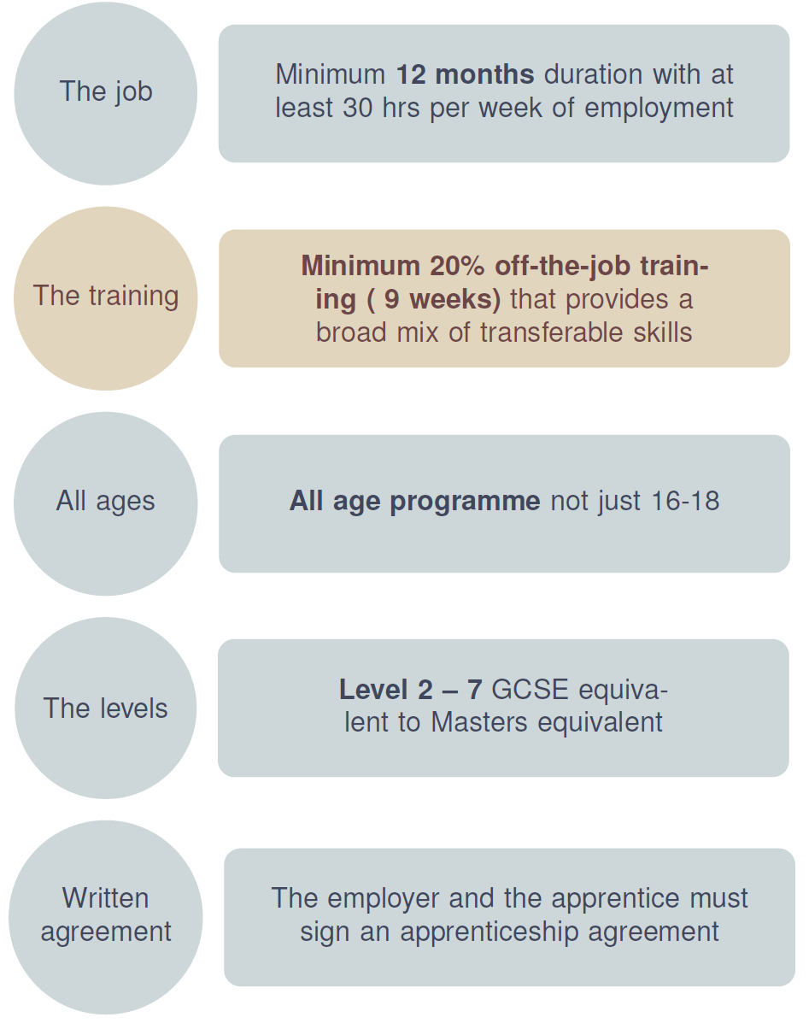
Key Features of the Standards Based Apprenticeship

Slide 19
Partnership with apprentice
Employer-led
Skilled occupation
Transferable
Institute approved standard
On-the-job training
= a modern Standards based apprenticeship
quality
20% off-the-job training
Literacy and numeracy
Occupational competence
Certification
End-point assessment
External Quality Assurance

Slide 20
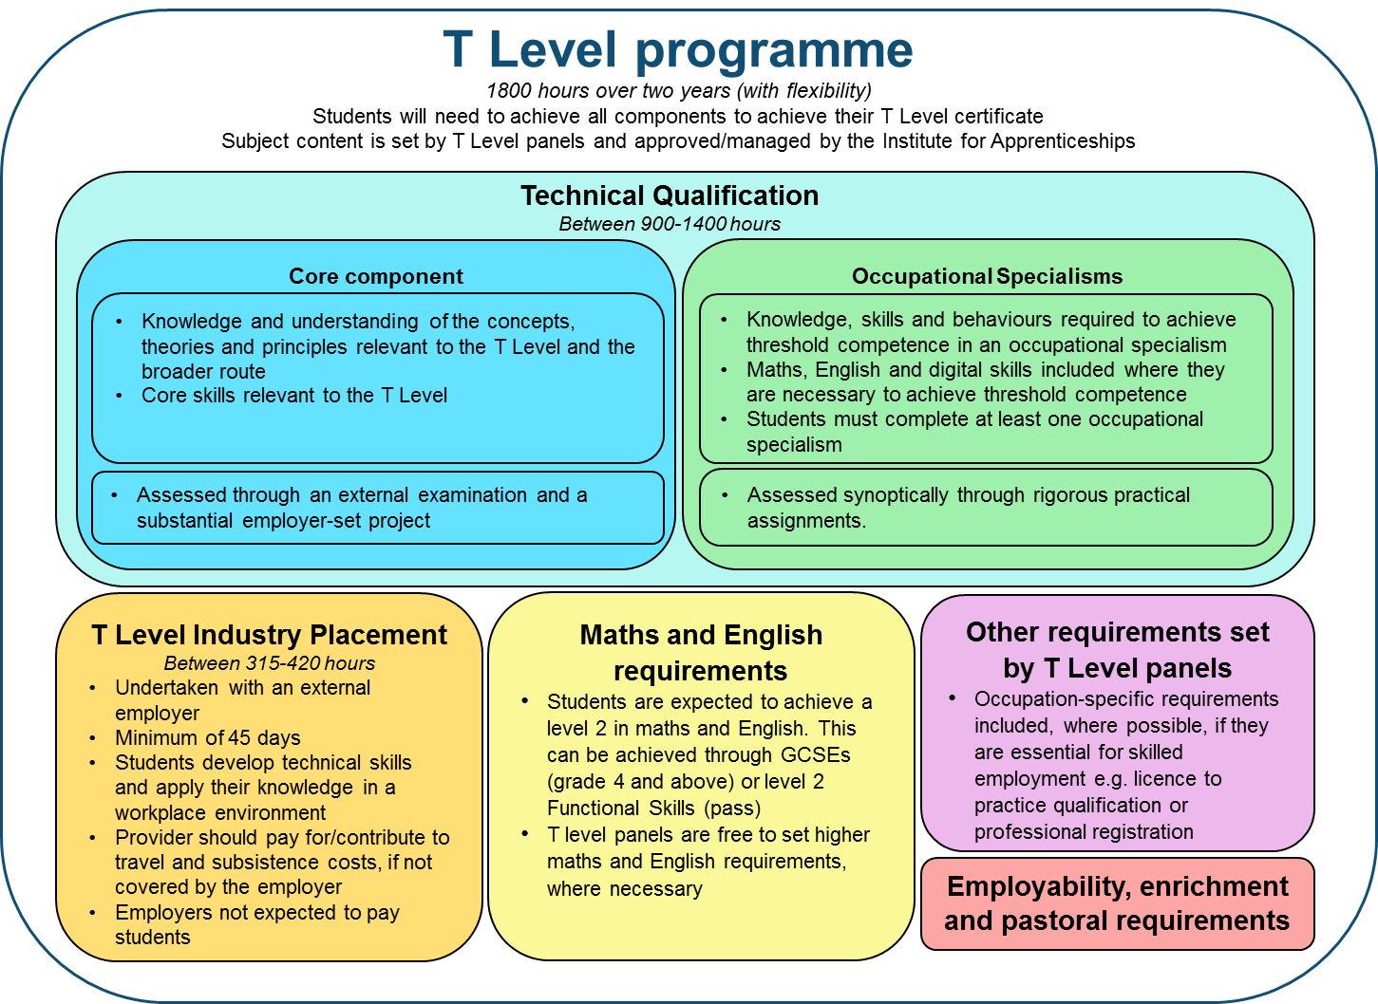
T-Level Composition

Slide 21
Annex A: Updated slides on Cumulative Starts on Standards (slide 5) and Strengthening of Training (slide 6)

Slide 22
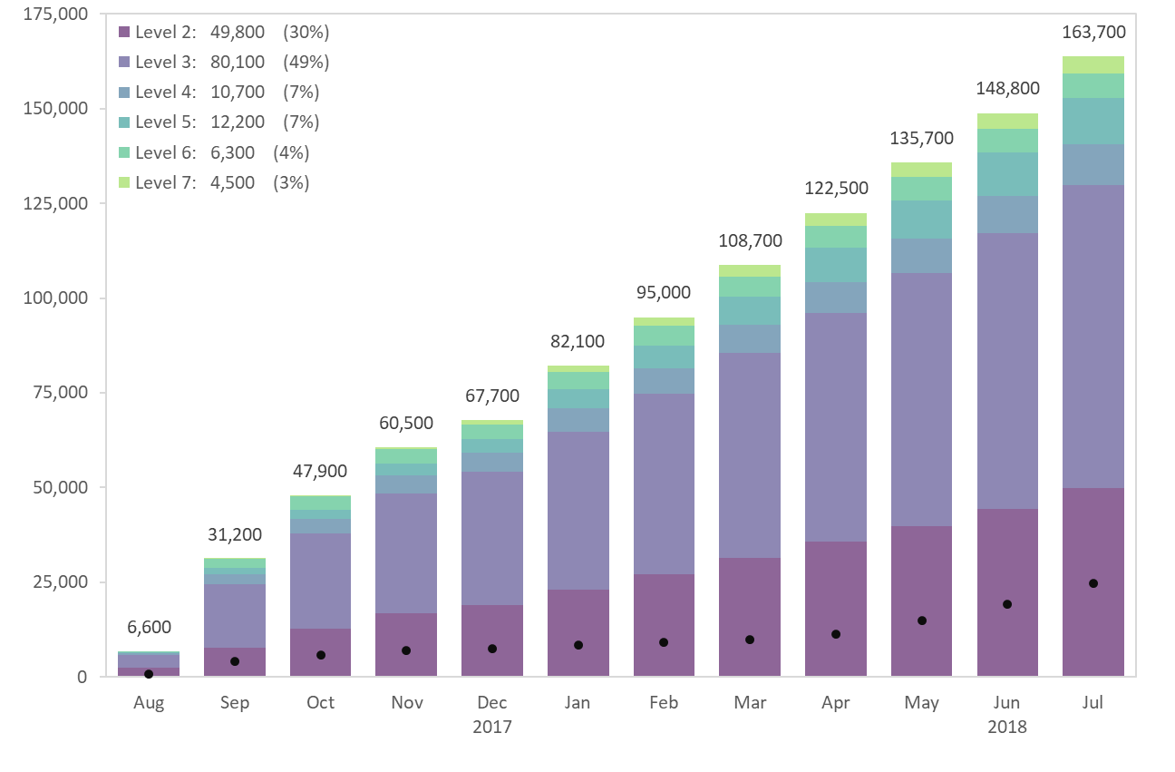
Cumulative Starts on Standards
Notes:
The chart shows cumulative starts on standards by month and detailed level for academic year 2017-18, compared to the previous year. This slide has been amended to reflect the most up to date publicly available data. This data is available as part of the further education and skills SFR:
https://www.gov.uk/government/collections/further-education-and-skills-statistical-first-release-sfr
With the specific breakdown, by month and detailed level, available: (https://assets.publishing.service.gov.uk/government/uploads/system/uploads/attachment_data/file/761151/Monthly-apprenticeship-starts_SSA-Fwk-Std-Age-Level-Fund_Nov2018.xlsx), which may give slight rounding differences with the main summary tables.

Slide 23
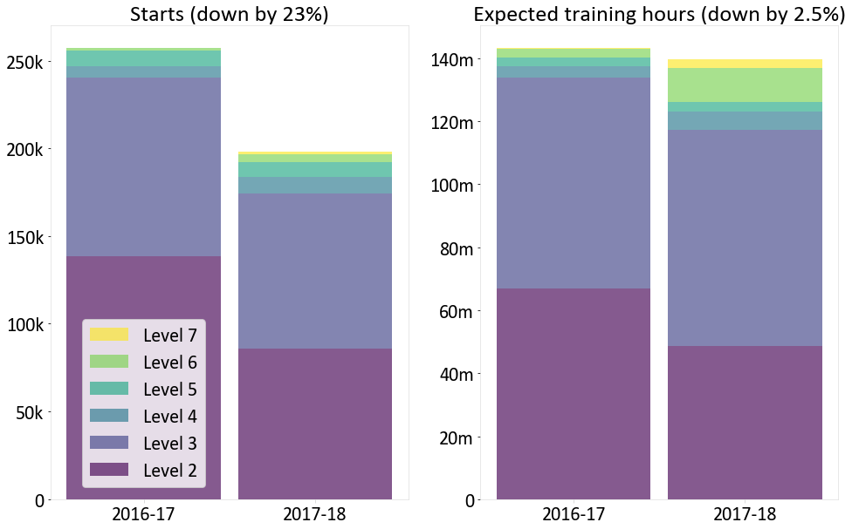
Strengthening of Training
Notes:
The original presentation contained a previous version of the expected hours of off-the-job training. This slide has been amended to reflect the most up to date publicly available data. This data is available as part of the further education and skills SFR:
https://www.gov.uk/government/collections/further-education-and-skills-statistical-first-release-sfr
It was published in the main text accompanying the November 2018 apprenticeship and levy statistics:
https://www.gov.uk/government/statistics/apprenticeship-and-levy-statistics-november-2018
The charts on this slide show that between 2016/17 and 2017/18, August to January starts decreased by about 23 per cent whereas the expected training only decreased by about 2.5 per cent. The minor reduction in expected training despite the large reduction in starts is mainly due to the increase in starts on higher level apprenticeships in 2017/18, since these have greater training requirements.
The average expected duration of an apprenticeship increased from 529 to 612 days in the first half of 2017/18, and the average associated expected off-the-job training hours have increased from 560 to 700.
https://assets.publishing.service.gov.uk/government/uploads/system/uploads/attachment_data/file/766962/Apprenticeship-and-levy-statistics-December-2018-2.pdf

